Slide 1
A-Team
Project 6X6 Tic Tac Toe Game
By Ibra, Eddie, Jason, Carrie, Alexis, Alfonso

Slide 2
Introduction
Classic Tic-Tac-Toe:
Two players are involved
In a 3x3 grid
Players have an X or an O
Our project:
In a 6x6 grid
To win fill entire grid

Slide 3
Purpose of the Game
Purpose: win against your opponent
Winner will be determined once grid is filled.
The player with most 4 spaces in a row wins
Rows must be :
Vertical
Horizontal
Diagonal
Overall, have fun playing.
Notes:
GOALS: To play the game during downtime, to be entertained and to win the game.
TASKS:
3

Slide 4
How the game will work
User will be given a login menu
User can either log in or register.
The user selects:
Player vs. Player (PvP)
Player vs. A.I.(PvA)
Player's statistics will be saved under username.

Slide 5
New User Requirements
New User Requirements:
Register user.
Menu to choose PvP or PvA.

Slide 6
Existing User Requirements
Existing User Requirements:
Login and authentication.
Menu to choose PvP or PvA.
Notes:
GOALS: To play the game during downtime, to be entertained and to win the game.
TASKS:
6

Slide 7
Special case of Player vs Player
Player vs Player:
Log in and choose PvP.
Game starts as Player vs Player.
Update the score as squares connect.
Notes:
GOALS: To play the game during downtime, to be entertained and to win the game.
TASKS:
7

Slide 8
Special case of Player vs AI
Player vs AI:
Log in and choose PvE.
Game starts as Player vs AI.
Update the score as squares connect.

Slide 9
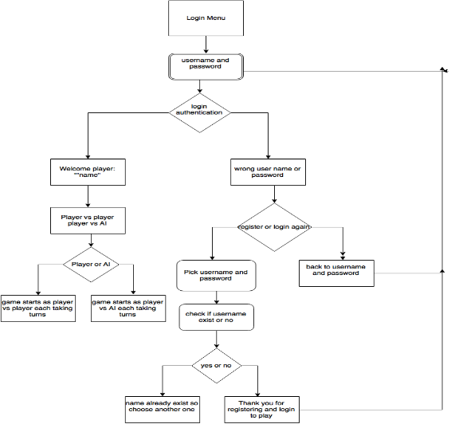
Game flow diagram

